Slide 1
Chapter 29 Linear programming--overview
Application of linear programming
  political problem: how to allocate the money for advertising to maximize the votes
  fractional knapsack problem
Overview of linear programming
Simplex method

Slide 2
How to allocate advertising money to maximize votes--model
Four political issues
  Build road
  Gun control
  Farm subsidies
  Gasoline tax
Three areas:
Estimated effect of $1000
Q: to win 50% support,
what is the best allocation?
- minimum money
area | Urban | Suburban | Rural
#voters | 100 k | 200 k | 50 k
Win 50% | 50 k | 100 k | 25 k
Policy | Urban | Suburban | Rural
Build roads | -2 k | 5 k | 3 k
Gun control | 8 k | 2 k | -5 k
Farm subsidies | 0 | 0 | 10 k
Gas tax | 10 k | 0 | -2 k

Slide 3
Allocate advertising money
Trial & error:
Feasible?
Can we do this with fewer $$?
Build roads | Gun control | Farm subsidies | Gas tax
$20 k | 0 | $4 k | $9 k

Slide 4
A math formulation
Assume
Build roads | Gun control | Farm subsidies | Gas tax
$ k | $ k | $ k | $ k

Slide 5
Fractional knapsack problem
Given n items with weight set W and value set V and w0
Select some items or fractions of items with
  Total value maximized
  Total weight =<

Slide 6
Overview of linear programming
Standard & slack forms
Extreme points (exterior point, vertices), fundamental theory
Algorithms
  Simplex method:
    move from one feasible exterior point to another exterior point
    average time is very good, worst case: exponential
  Ellipsoid algorithm
    by former Soviet mathematician Khachiyan in 1979
    not practical, worse average performance than simplex
  Interior point methods
    move from interior to interior to arrive at an optimal exterior point
    the 1st one was by Karmarkar in 1984, outperform simplex method for large size problems.

Slide 7
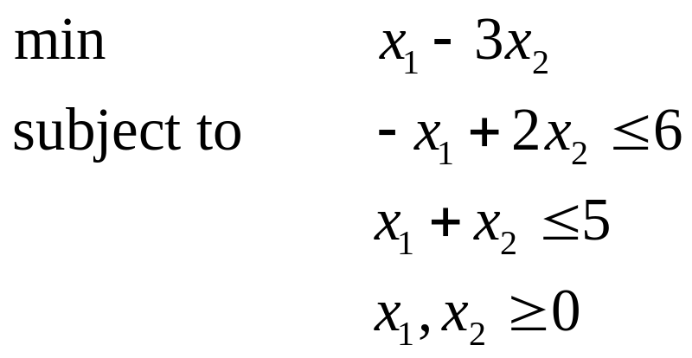
Example
Solution space S:
Extreme point (vertex)
Descent direction
Fundamental theory:
Standard form
Slack form

Slide 8
Linear Programming and Simplex Method
Slack form
min
subject to
  objective function
  S a polyhedral, constraint set
Fundamental theory of LP: Let extreme points of S be
If S is not empty and bounded, then one of extreme points is optimal
Complexity of algorithms for linear programming

Slide 9
Simplex Method--basic idea
Designed by Dantzig in 1947
Basic idea: because one of the extreme points is optimal, we start at an extreme point and
  test if the current extreme point is optimal
  if not, move to next extreme point with lower objective value
finite # extreme points => can always find an optimal solution with finite steps
Terminology: for the current extreme point
  basis, basic variable, non basic variables,
Example

Slide 10
Extreme Points
Standard form
Slack form

Slide 11
Two Key Questions in Simplex Method
How do we know if the current extreme point is optimal?
If not, which extreme point with is next?

Slide 12
Simplex Method Summary
Initialization: find a starting extreme point with basis B
Main step: For the current extreme point with basis B calculating
  if non positive, stop, is optimal
  otherwise, pick the most positive component
    if , then stop, the objective value is unbounded
    otherwise, form the new basis by deleting from B and introducing
    calculating the extreme point with the new basis and replace the current extreme point.
  repeat the main step.

Slide 13
Tableau Format of Simplex Method

